Slide 1

Application: EzCars Type: Application Architecture View: Logical View Style: Layered Architecture Pattern
Users
Delivery Channels
Core Business Processes
Data And Information
Technology Enablers
Authentication
& Authorization
User Details
Payment Gateways
Booking Management
Vehicle Data
Google Maps API
Booking Data
Search & Filter Logic
Renters
Web Browser
Payment
Cloud Services (AWS )
Payment Confirmation
Review Data
Email Service
Review & Rating
Pricing Information
Github & Delivery Pipeline
Admin
Customer Support
Availability Schedules

Slide 2
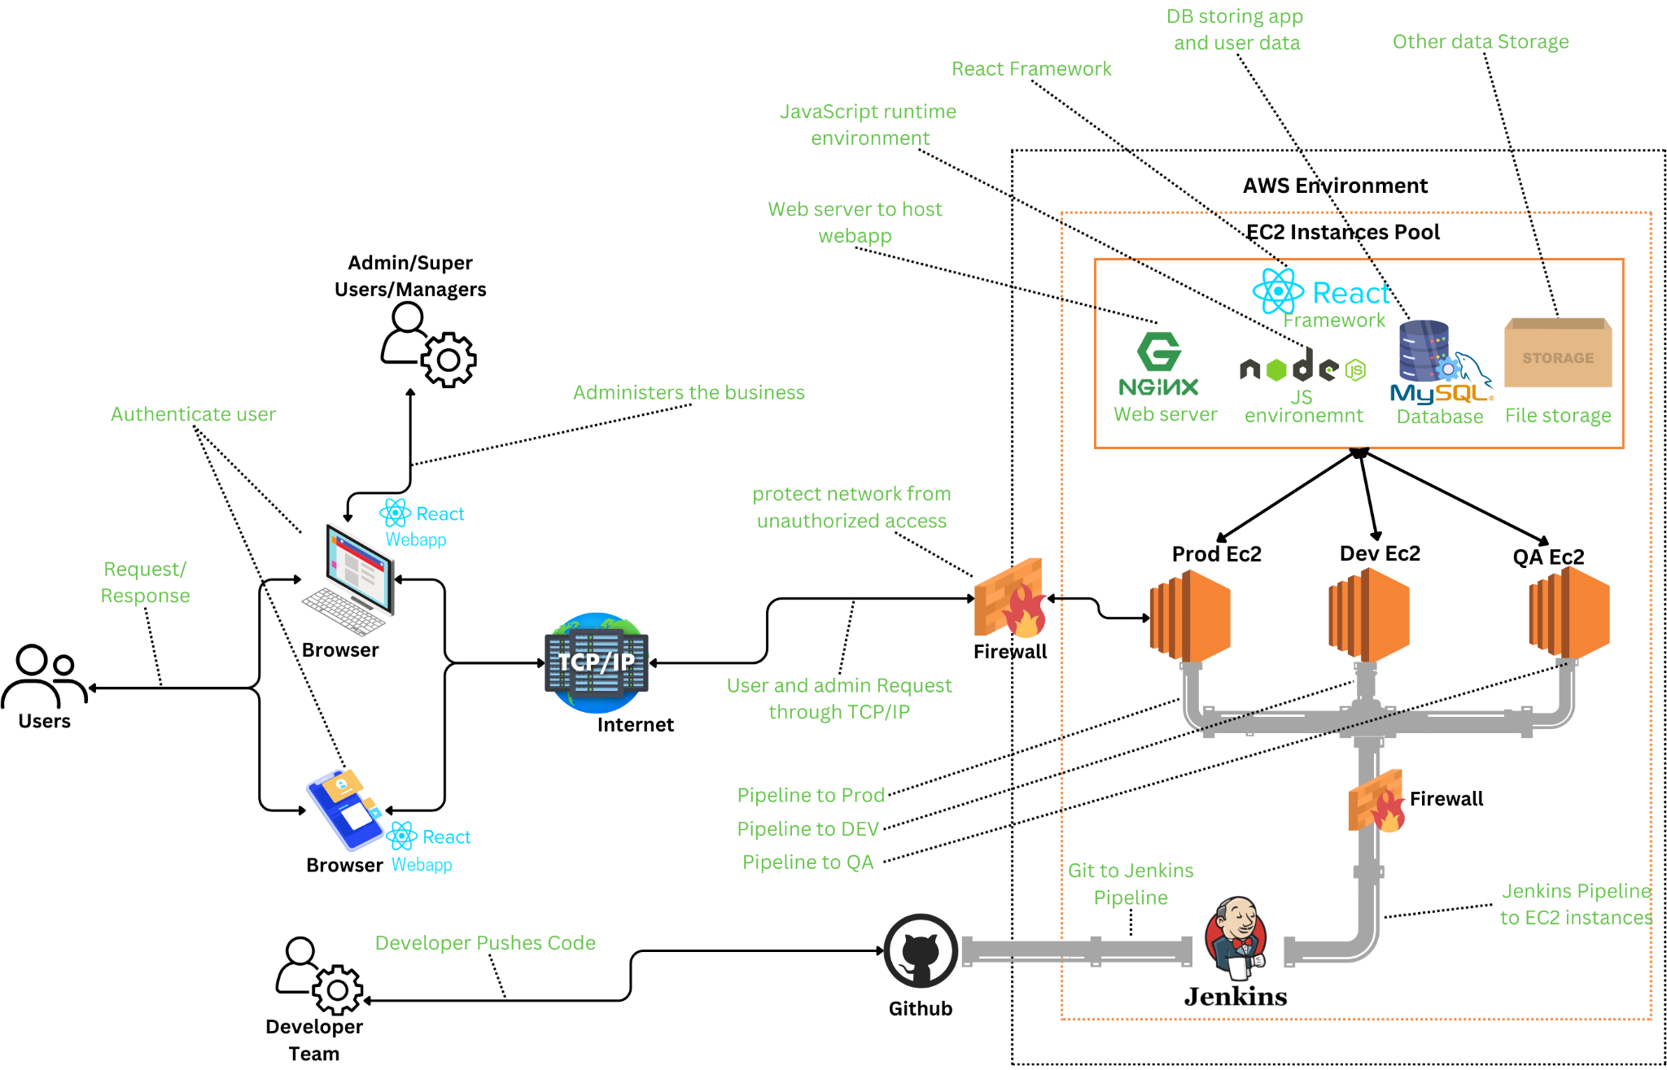
Application: EzCars Type: Application Architecture View: Process View Style: Client-Server Pattern

